Slide 1

COVIDgilance Tracker Paul Kazalski, Flomo Kokro, Will Giordano, Maria-Elena Gorini, Meghna Agnish

Slide 2
Our Objective
Use data visualization programs and machine learning algorithms to describe the risks posed by COVID as accurately and as clearly as possible.
Specifically, COVIDgilance has performed the following:
Pandas: Clean and consolidate data from various sources
Tableau: Visualize COVID statistics by county
Seaborn, Gmaps, Folium, Matplotlib: Visualize COVID statistics by other parameters
SKLearn: Create Logistic Regression and Risk Assessment
Prophet: Forecasts COVID statistics

Slide 3




Data Sourcing and Cleaning

Slide 4

Machine Learning: Now We’re Cooking!
Producing a Machine Learning model is like developing the perfect meal
Good data = good ingredients
Pay for Premium or short-order?
Algorithms = source of heat
Expertly cooked steak or sushi?
So what makes or breaks the perfect recipe?
The preparation!

Slide 5
Our Data Sources
Numbers surrounding COVID-19
Total Cases New York Times GitHub
Deaths New York Times GitHub
Demographics
Age (70+) 2018 Census Data
Gender (Male) 2018 Census Data
Social Distancing
Implementation Date Unacast
Degree of Reduced traffic Unacast
Healthcare Data
Health Behaviors RWJ County Health Rankings
Clinical Care RWJ County Health Rankings
Social and Economic Factors RWJ County Health Rankings
Physical Environment RWJ County Health Rankings
Location
Population Density 2018 Census Data
Mass Transit Usage American Public Transport Association

Slide 6
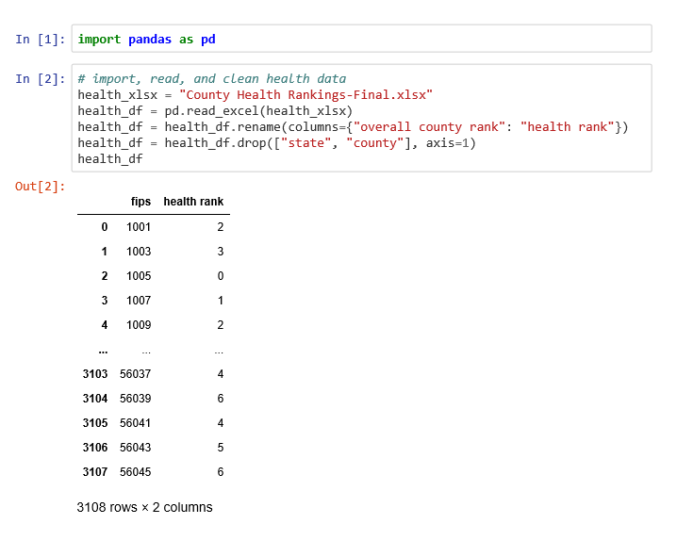
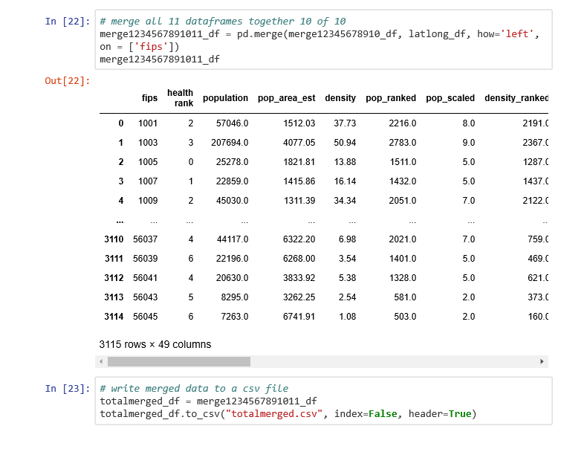
Big Data Excel stored, Jupyter merged

Slide 7
Visualizations

Slide 8
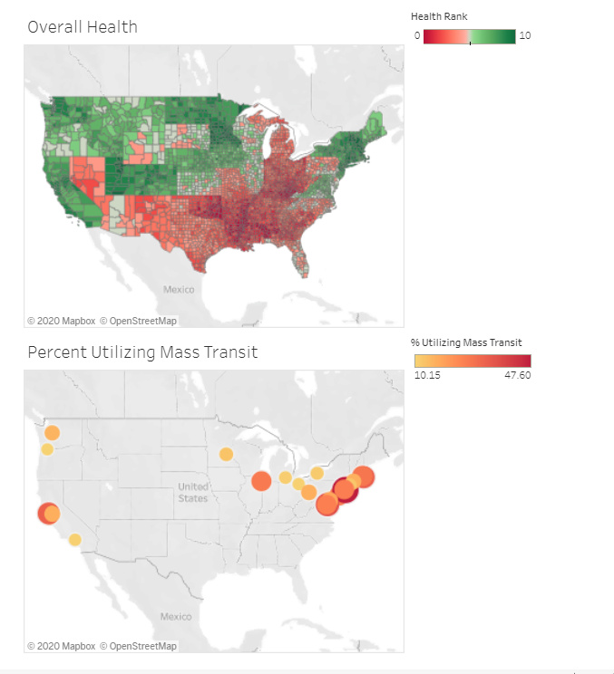
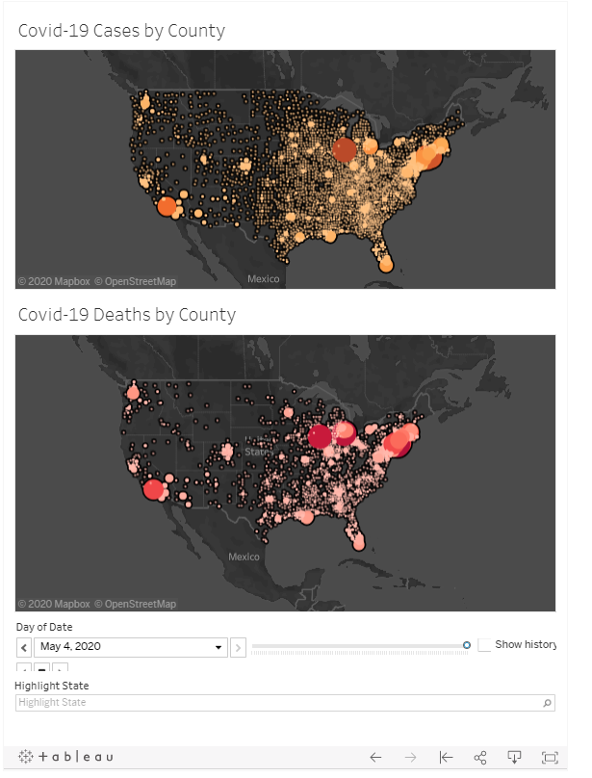
Tableau Visuals
Attributes by County
COVID-19 Cases and Deaths Per County by Date

Slide 9
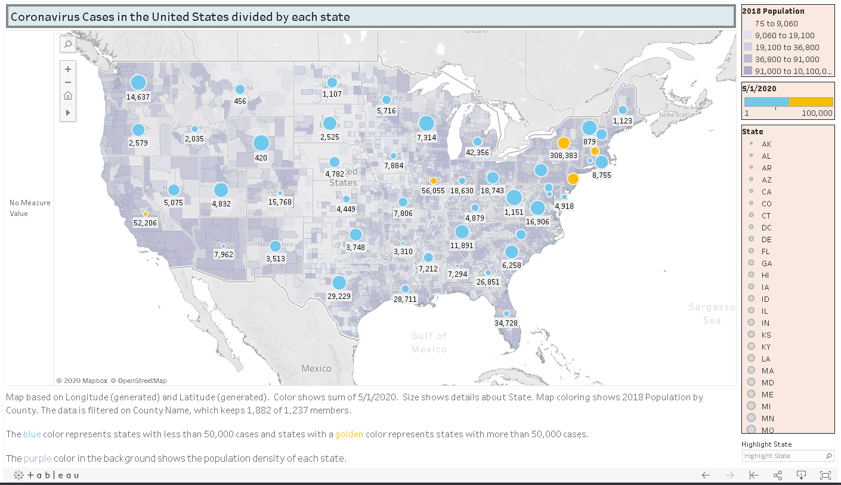
Tableau Visuals 2
COVID-19 Tableau of Cases in the United States divided by each state

Slide 10
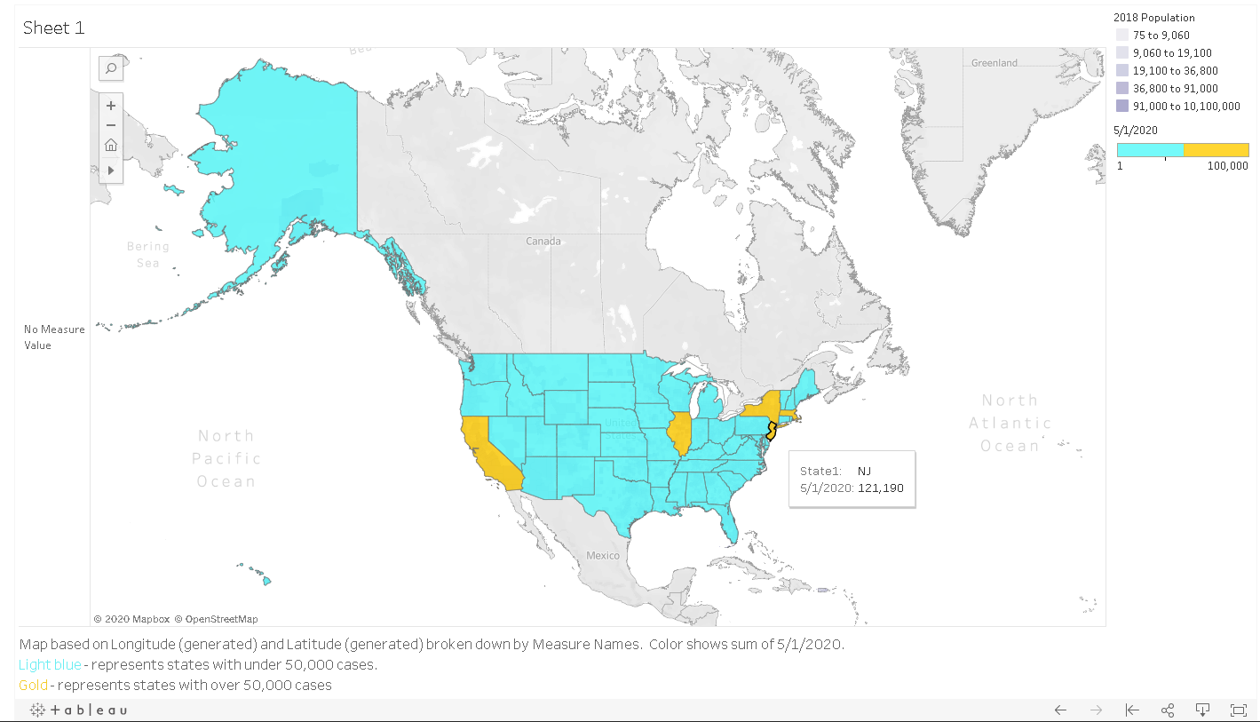
Tableau Visuals 3
COVID-19 Tableau of Cases in the United States divided by each state

Slide 11
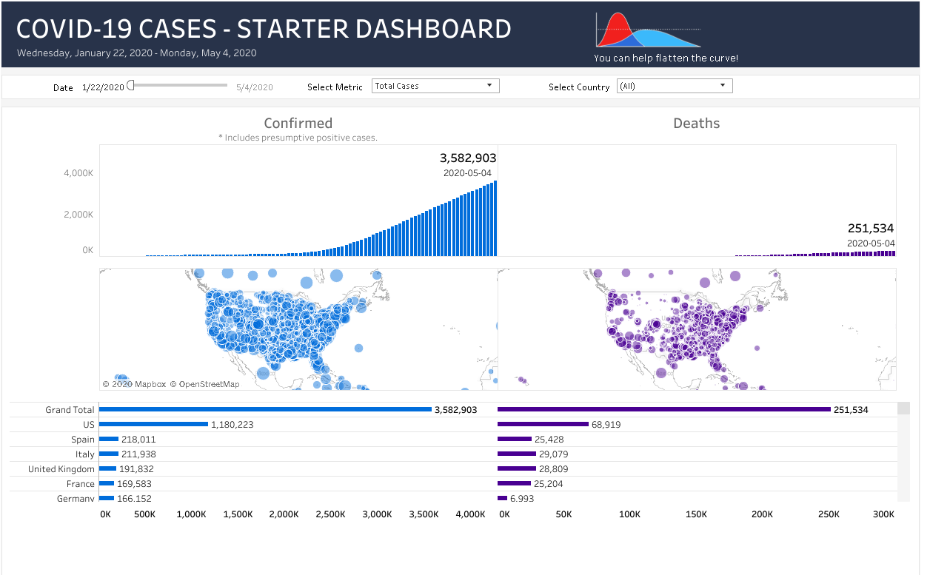
Tableau Visuals 4
COVID-19-Cases in the United States using Tableau

Slide 12
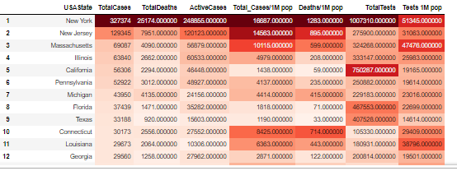
Color-scaled Table of COVID Cases by State

Slide 13

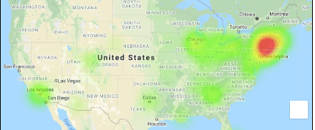
U.S. COVID Cases Heatmap

Slide 14
Visualizing Total Cases and Recoveries with Seaborn

Slide 15
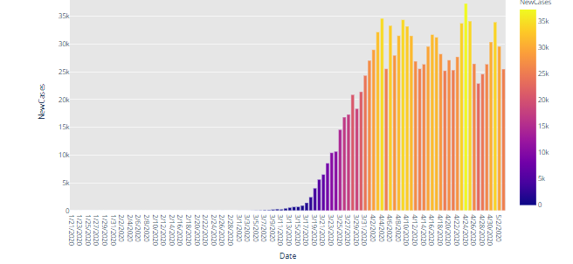
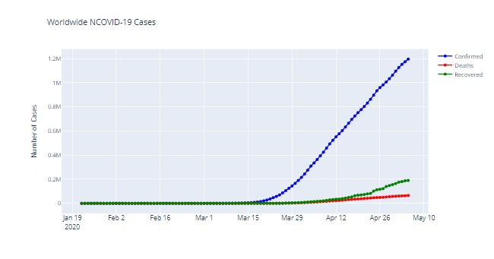
x-y Charts of COVID Statistics in Plotly – Jupyter Notebook
Images for top to bottom
New Coronavirus confirmed case by date.
New Case seven day prediction using fbforecast and plotly.
Confirmed cases, recovered, and deaths using plotly.

Slide 16
x-y Charts of COVID Statistics in Plotly

Slide 17
Machine Learning

Slide 18
Risk Assessment Analysis
Logistic Regression Model
Purpose of the model: classify county risk impact based on features
Preliminary Modeling work:
Checked the dataset for nulls
Features included cases, deaths, population density and age
Output variable – Impact
Features for risk profile of US counties:
Population density
Age demographics with focus on over 70
Rank features and create ranges to normalize the data:
Final range column was created as a means of all ranges
Counties were placed into Low, Medium, High and Critical categories

Slide 19
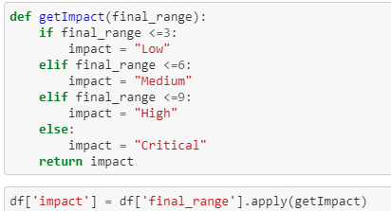
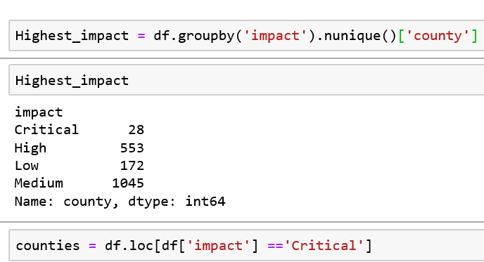
Risk Assessment Analysis
Training and testing the model
Accuracy rate – Trained data - 62.68%
Accuracy rate – Tested data - 62.61%
Not much improvement with Grid search method – 62.67%

Slide 20

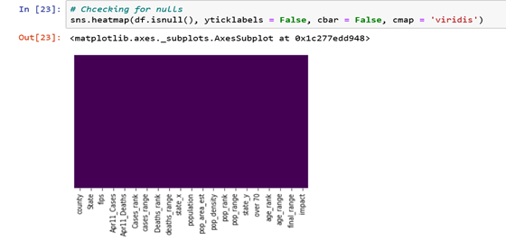
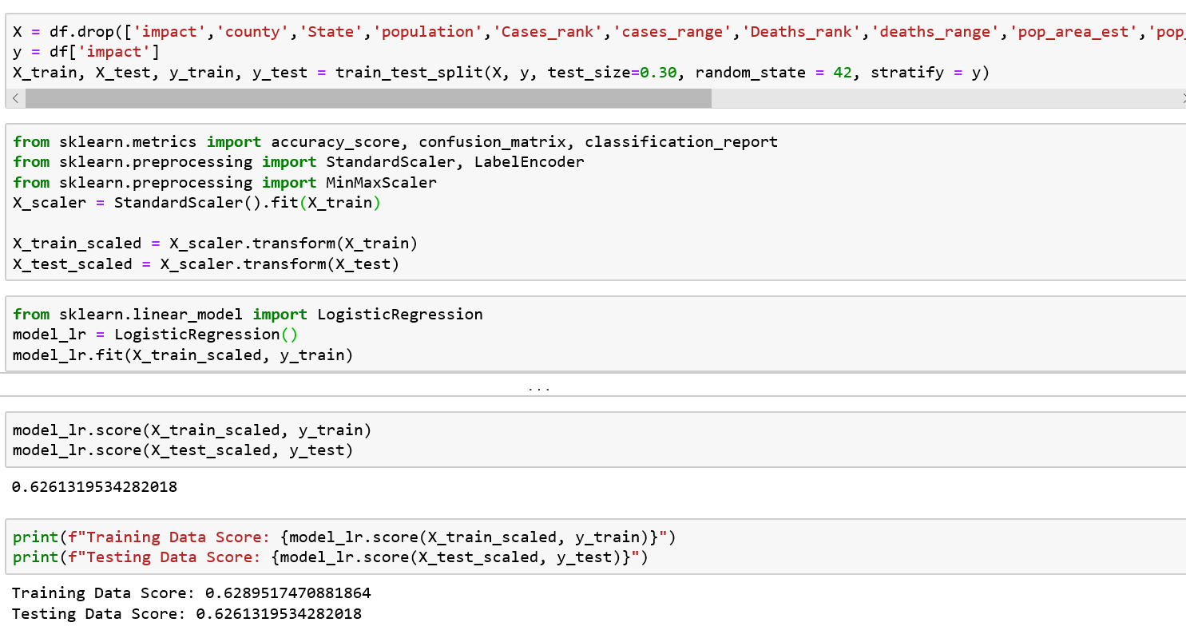
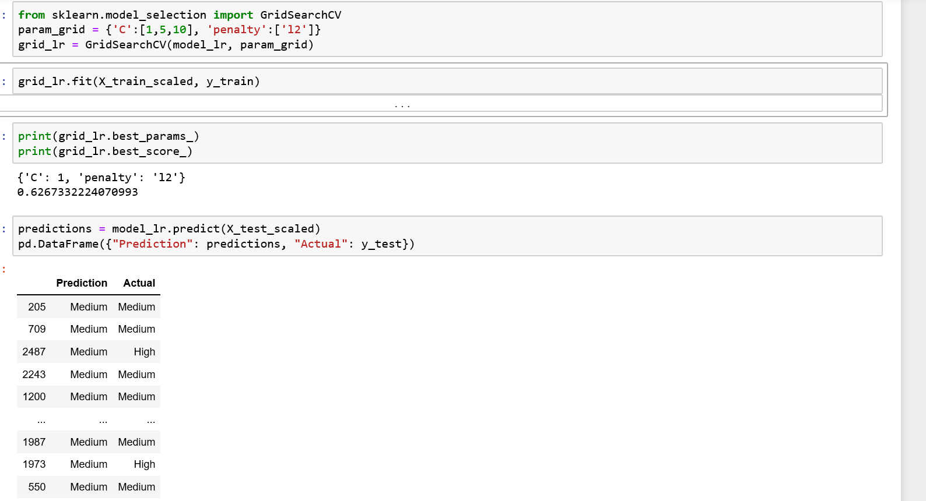
Risk Assessment Analysis
Logistic Regression Model

Slide 21
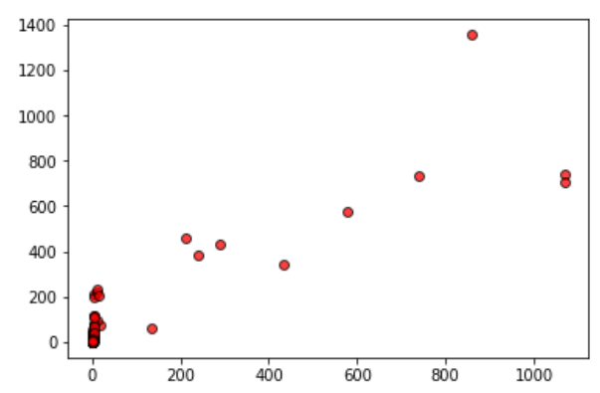
Logistic Regression
Results:
Deaths (top) R²: 0.5
Cases(bottom) R²: 0.07
Neither Case great
Diagnosis:
Decent at determining whether cases are “high” or “low”
Very bad at guessing values
Analysis:
3000 datapoints not enough
Double up dates OR bin cases/deaths & use SVC
Data Inputs:
Population Density
% Population over 70
% takes Mass Transit
April 11 Cases/Deaths
April 15 Cases/Deaths
Data Output
April 18 Cases/Deaths
Data points
U.S. Counties
Include D.C.
Exclude HI and AL

Slide 22
Machine Learning To-Do List
Add more features
Optimize data points
Add proximity data (major cities)
Bin statistics in “high”, “medium”, and “low”
Double-Up dates for rows created in Machine Learning

Slide 23
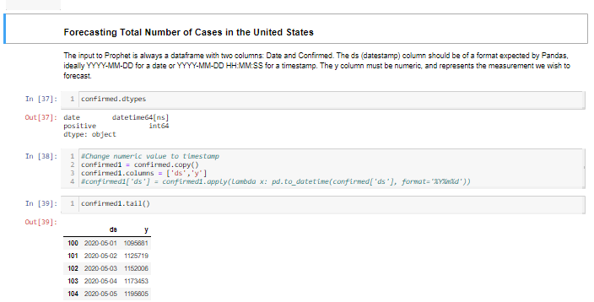
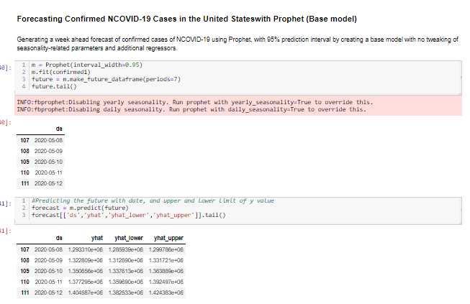
Forecasting
Total Number of Cases Countrywide
Prophet
Prophet is open source software released by Facebook’s Core Data Science team. It is available for download on CRAN and PyPI.
We use Prophet, a procedure for forecasting time series data based on an additive model where non-linear trends are fit with yearly, weekly, and daily seasonality, plus holiday effects. It works best with time series that have strong seasonal effects and several seasons of historical data. Prophet is robust to missing data and shifts in the trend, and typically handles outliers well.
Why Prophet?
Accurate and fast
Fully automatic
Tunable forecasts
Available in R or Python

Slide 24
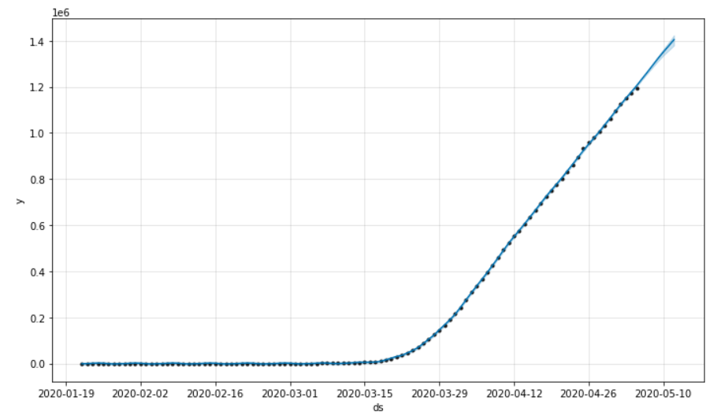
Prophet Forecasting Results – U.S.
Seven-day prediction of Coronavirus case in the United States.
We see a study increase in case over the next seven days.
We also see that most cases are reported on the weekends.

Slide 25
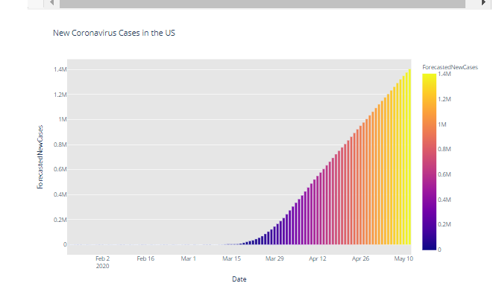
New Cases by Day of Week
14-day prediction using fbprophet shows a study increase in new cases per-day.

Slide 26
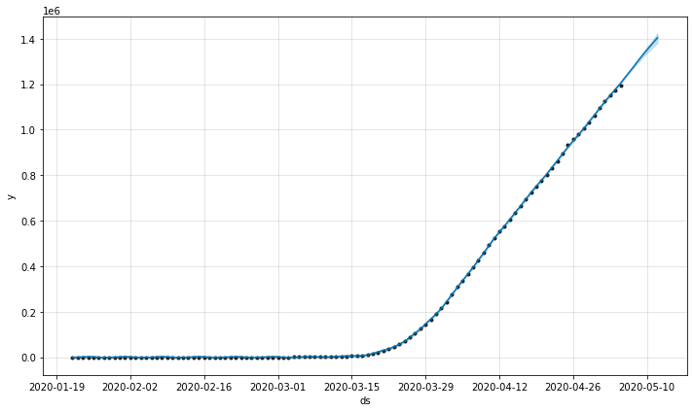
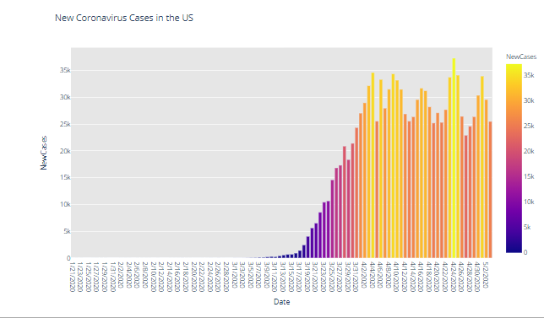
Conclusion:
We have cause to be optimistic.
The data shows some flatten in the curve for new cases.
A study rise in confirmed cases using fbprophet

Slide 27
Questions?

Slide 28
References
us_daily.csv - https://github.com/COVID19Tracking/covid-tracking-data/blob/master/data/us_daily.csv
worldmetersUS1.csv - https://www.worldometers.info/coronavirus/country/us/
Notebook Reference - https://colab.research.google.com/drive/1_I9hdYF9tE4EKI9WEuojYdUYXHXG04I9#scrollTo=UDv_-qMRepkF
Data - 2018 Census Data; New York Times GitHub;

